Slide 1
Small Commercial Building Energy Retrofit Solution
The Intelligent Application of Technologies
to Achieve Permanent Load Reduction
Presented by:
Erik Ahrens
Central California Regional Manager, L&H Airco

Slide 2
Serving California Since 1968
Turnkey Solutions
Design, Engineering, Development
Licensed Mechanical and Electrical Contractor
Leading Energy Solutions Provider
Nearly 100 Industry Professionals on Staff
Offices in Sacramento, Fresno and San Diego
Advanced Mechanical Equipment
HVAC and Lighting Controls
Energy Management, Monitoring and Reporting
Project Management, Installation
Service and Support
Notes:
L&H Airco is celebrating our 45th year in 2013. With nearly 100 employees in three offices we serve the energy needs of all building types throughout the state.

Slide 3
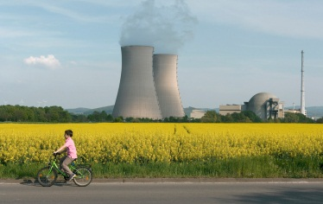
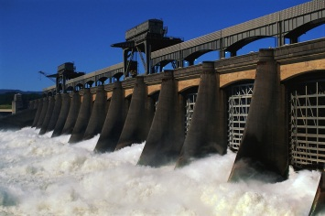
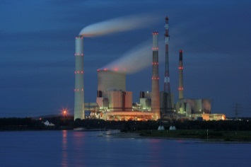
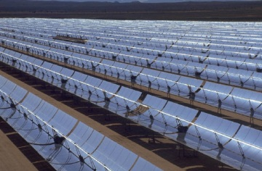
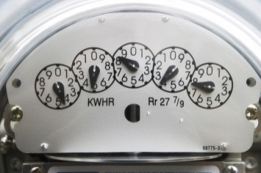
Permanent Load Reduction
Demand Response is great but why wait for a peak day event or TOU pricing triggers to limit energy usage?
What if buildings had very little available load to shed because they are already operating at minimum demand levels?
We are offering a permanent solution to combat the permanent problem of generation and transmission in California

Slide 4
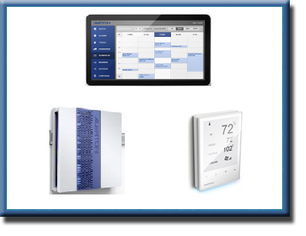
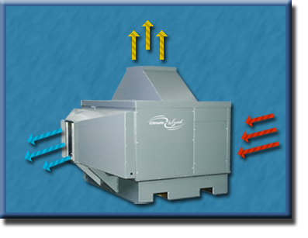
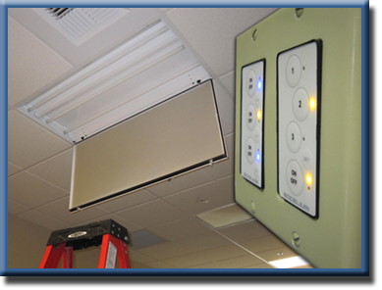
Controls
HVAC
L&H Airco
PLR Solution
Control
Lighting
HVAC
Lighting

Slide 5
Permanent Load Reduction Through The Convergence of Knowledge and Technology
Technology Is Important
We love technology - but we aren’t tied to any single one
Multiple great technologies are needed for maximum results
We have several of the best in HVAC, Lighting & Control

Slide 6
Permanent Load Reduction Through The Convergence of Knowledge and Technology
Applying Technology Properly Is More Important
We maximize the individual power of each technology by integrating them into a single unified and installed solution.
Application Engineering
Project Management
Installation
Software Development
Commissioning
Service and Support

Slide 7
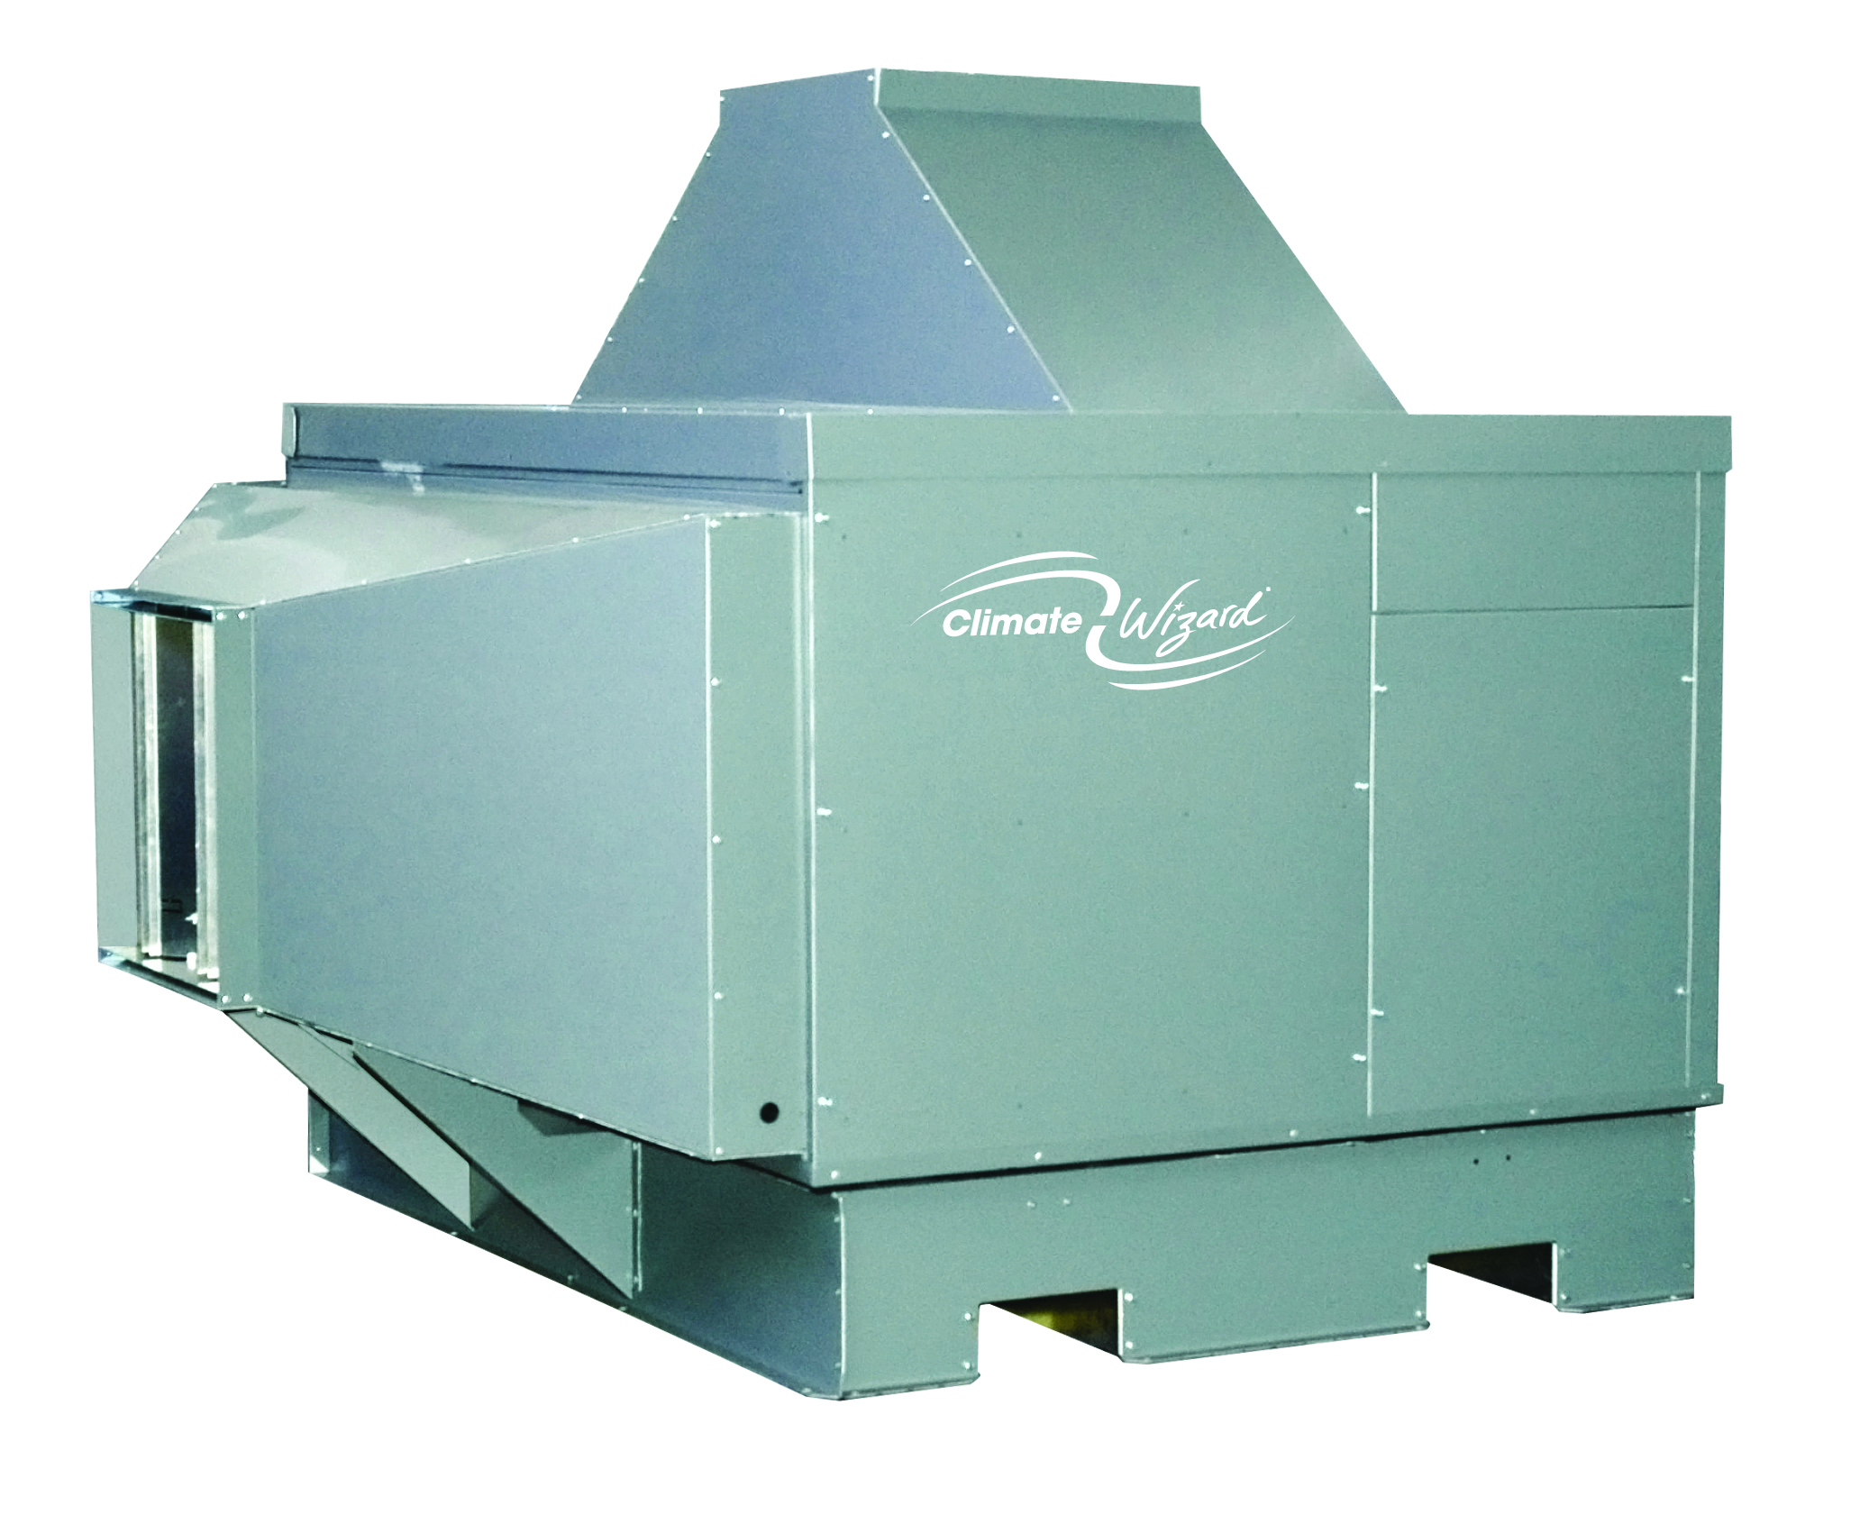
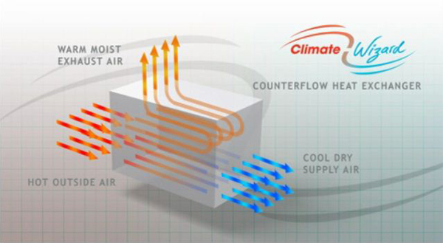
Indirect Evaporative Air Conditioner
Permanent HVAC Load Reduction
How Does It Work?
It uses the natural cooling power of evaporation to drastically reduce air temperature.
A world patented heat exchanger produces very cold air without added moisture.
How Is It Different?
No compressors or harmful synthetic refrigerants are used to cool the air. Integrated water management system conserves consumption and keeps the water distribution system healthy.
Cooling performance and energy savings improve as the temperature increases - when you need it the most.
Ultra-efficient heat exchanger and system design uses a fraction of power that refrigerated systems consume.

Slide 8
* Measured kW by PG&E testing, Average EER measured by WCEC testing ** Published product data by Carrier
The Difference Maker in the Industry
Saves up to 80% over refrigerated cooling systems.
6 ton Climate Wizard total power: 1.8kW (60.7 EER)*
6 ton Carrier Weathermaker total power: 6.4kW (11.0 EER)**
Constant electrical load regardless of temperature or cooling output.
Use for stand-alone cooling, pre-cool economizer air (cold front) or to supplement existing cooling

Slide 9
Permanent Lighting Load Reduction
Dimmable Lighting
Fluorescent Dimming Ballasts
Incandescent to Dimming LED
Control
Daylight Harvesting
Occupancy Control
TOD Scheduling
Ambient Light Sensing
Implementation
Task Tuning
Integration to other systems
Benefits:
Maintains constant lighting levels for maximum energy savings, occupant comfort and productivity
Extends the life of ballasts and lamps
Continuously shedding load to meet minimum lighting requirements
Less Lighting = Less Heat
Huge Potential for Energy Savings (30 – 70% of Lighting Load)

Slide 10
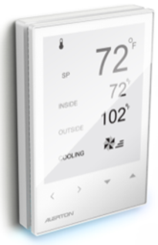
Permanent Load Reduction through Control
HVAC
Optimum start of equipment
Direct economizer control
Occupancy Status from Lighting
Custom control sequences to maximize Climate Wizard efficiency
Integration
Directly interface to monitor and control other systems
Energy Meters Irrigation
PV Systems Fire
Access Control Security
Emergency Generation
Mechanical Equipment
Demand Response (OpenADR)
Benefits:
Integrated Functionality
HVAC, Lighting and other systems work in concert with each other – saving energy.
Efficiency strategies and Demand Response commands are applied to all systems through a single platform.
Fault Detection
Fault conditions on any connected system are immediately detected and reported.
Control strategies can be implemented to account for failures.
Measurement & Verification
Energy and operational data available for viewing and analysis.

Slide 11
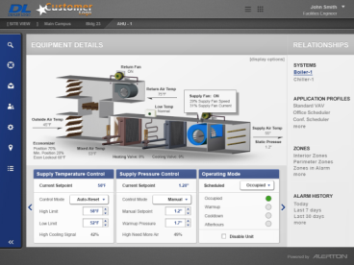
More Benefits of L&H Airco’s PLR Solution
Intelligent
Robust processing power and memory to accomplish sophisticated energy conservation control sequences.
Built-in array of powerful energy management features.
Open and Accessible
Industry standard open-protocol network (BACnet–ASHRAE 135) connects HVAC, lighting, controls and other technologies together.
Platform-neutral Graphical Interface provides intuitive monitoring and control of all building systems.
Scalable
Capable of controlling very large buildings and of connecting a large number of buildings together to form an Enterprise level system.

Slide 12
L&H Airco PLR Solution Summary
An aggressive approach to energy savings through the combined power of technology and know-how.
Effective, proven solutions for HVAC and Lighting working together constantly to achieve maximum efficiency at all times.
The people who know how to make it work and how to keep it working in the future.
A permanent solution to a permanent problem

Slide 13
THANK YOU
L&H Airco
Erik Ahrens, Central California Regional Manager
email: eahrens@lhairco.com direct: 559-301-9909

